Slide 1
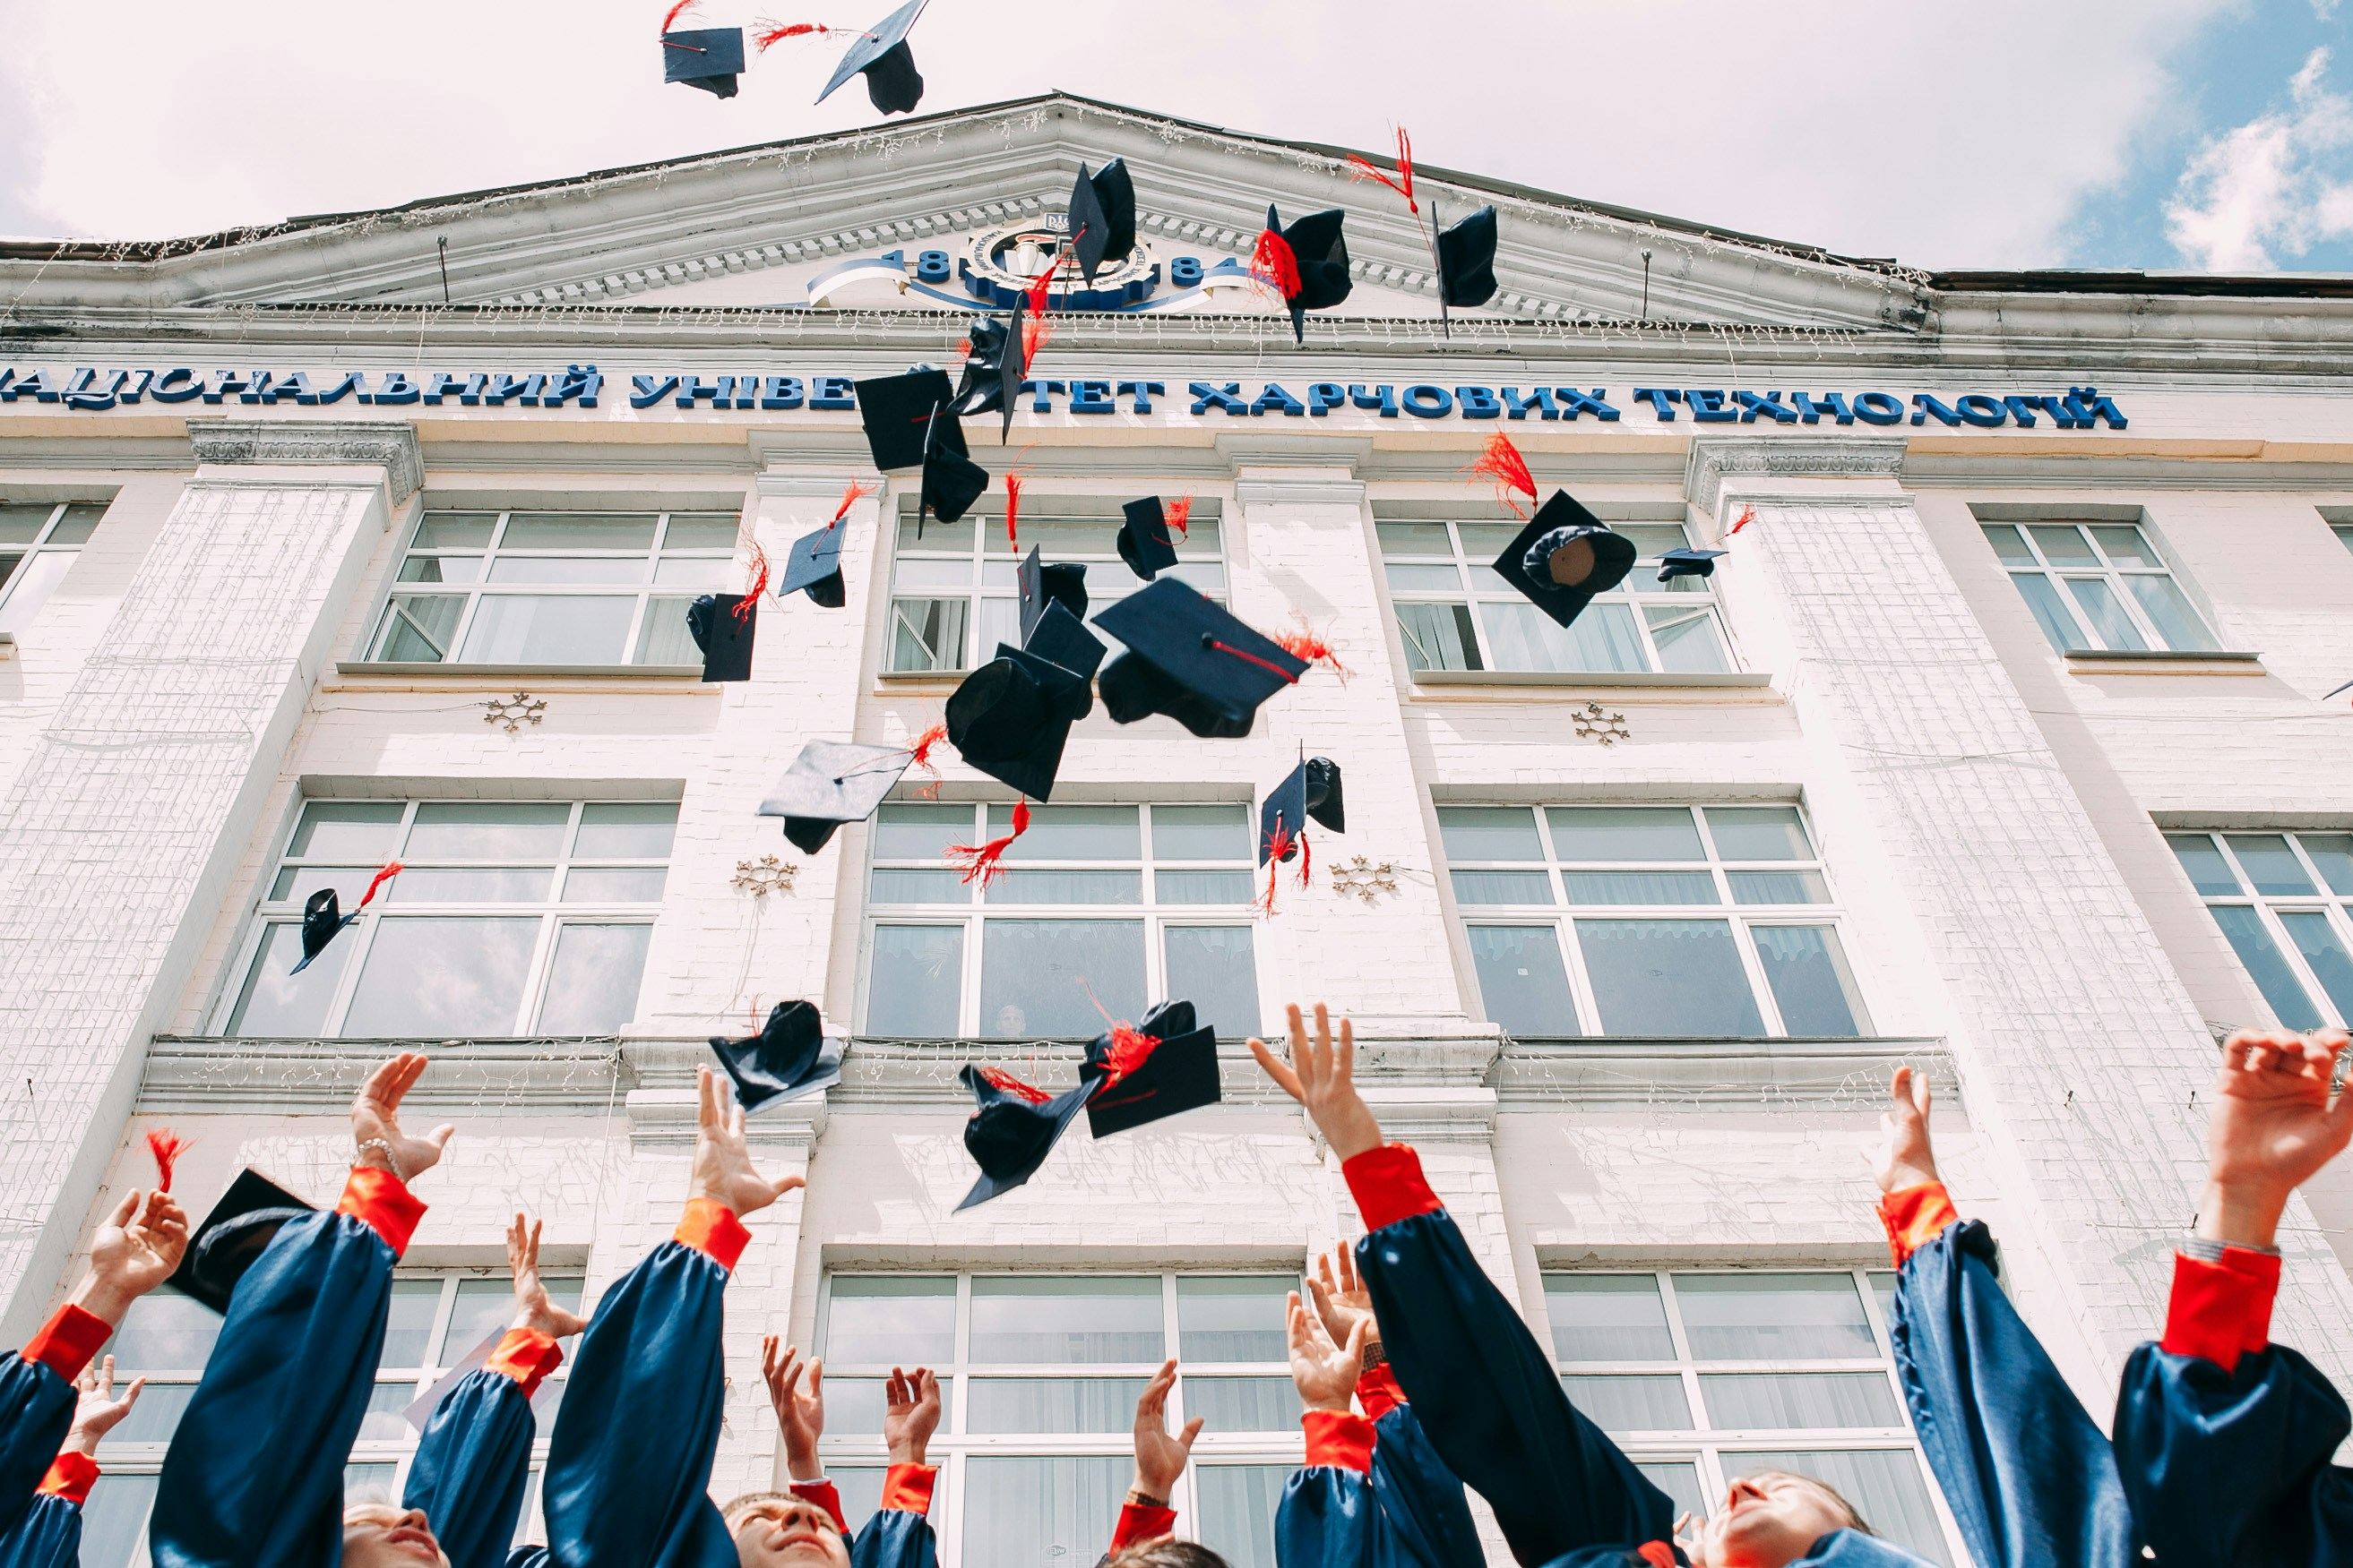
校園故事 (Animaze)
Notes:
https://unsplash.com/photos/group-of-fresh-graduates-students-throwing-their-academic-hat-in-the-air-8CqDvPuo_kI

Slide 2

目標
Notes:
https://unsplash.com/photos/group-of-people-watching-concert-U7HLzMO4SIY

Slide 3
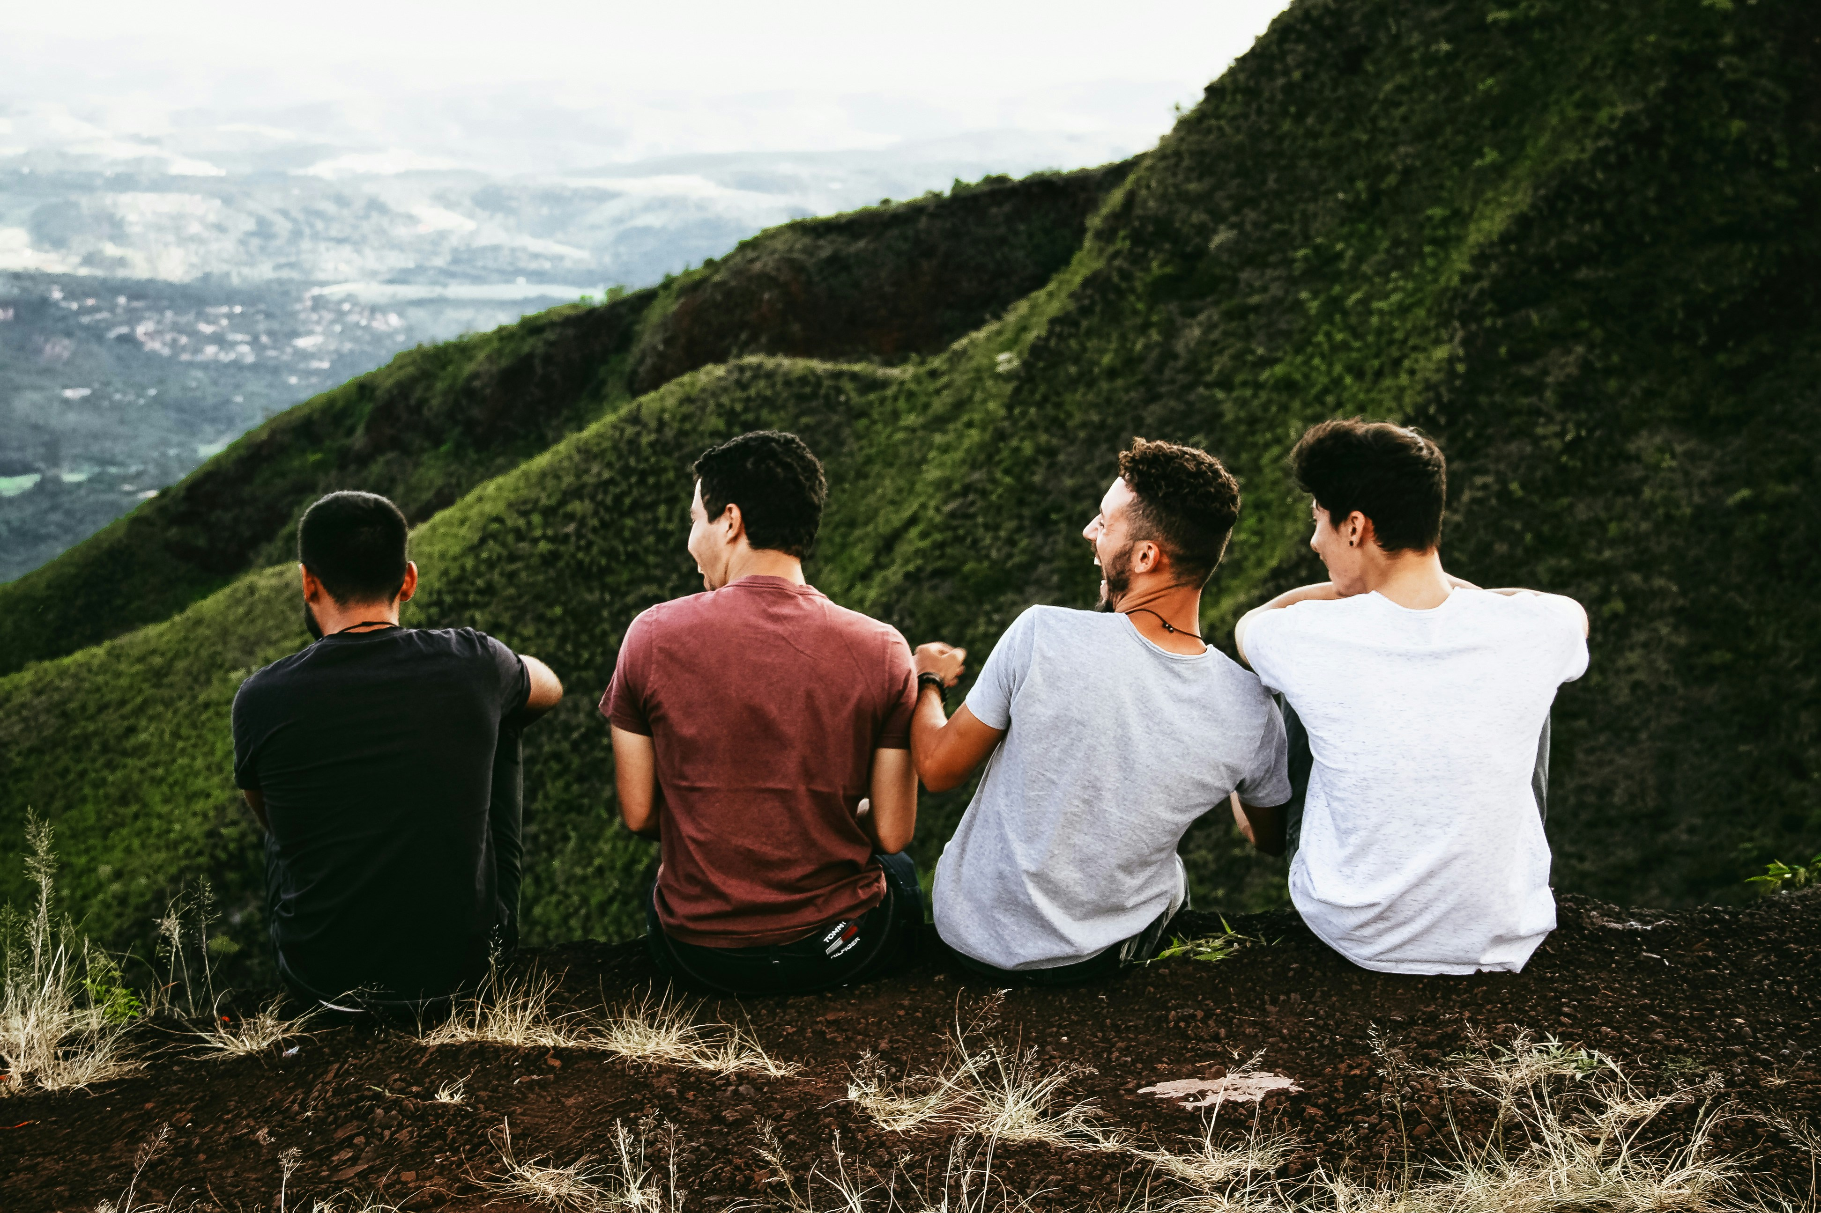
Notes:
https://unsplash.com/photos/row-of-four-men-sitting-on-mountain-trail-TkrRvwxjb_8

Slide 4
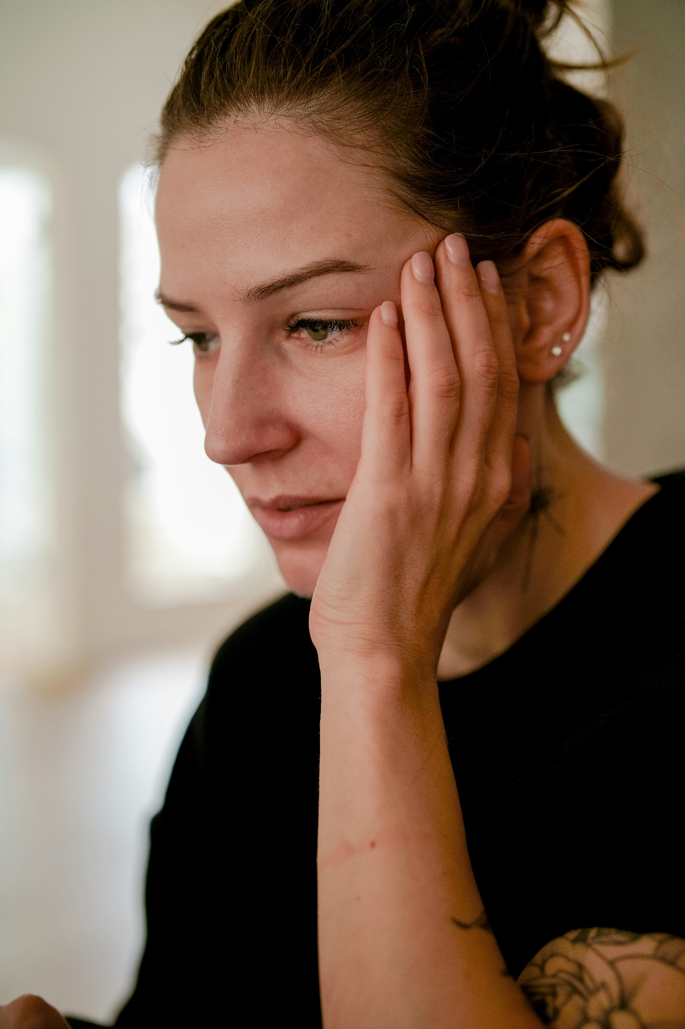
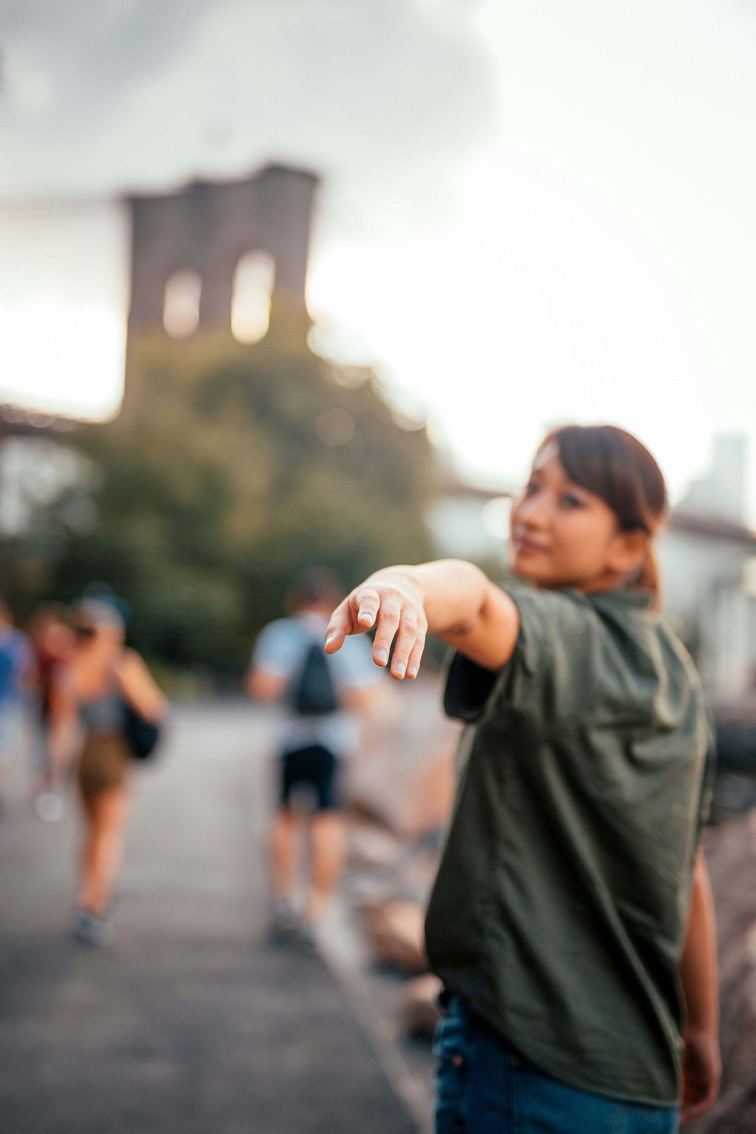
阻礙
Notes:
https://unsplash.com/photos/a-person-with-the-hand-on-the-face-HjTF52J2arI
https://unsplash.com/photos/selective-focus-photograph-of-woman-raising-her-hand-A5FaLf5d8nw

Slide 5
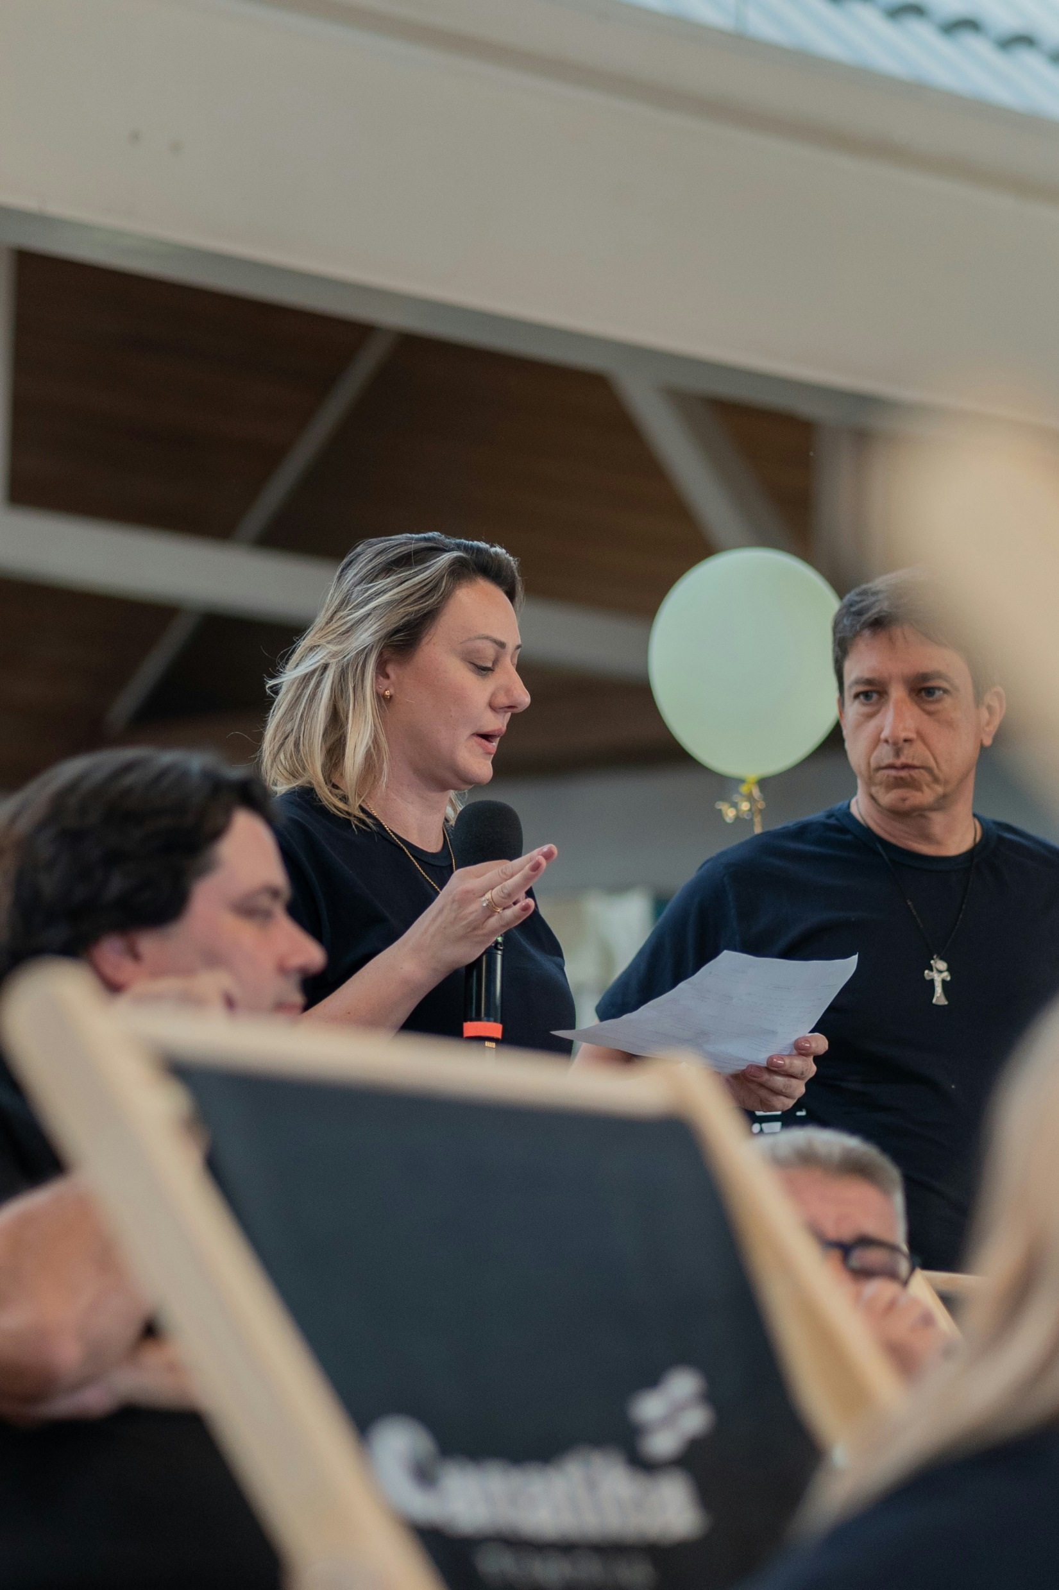
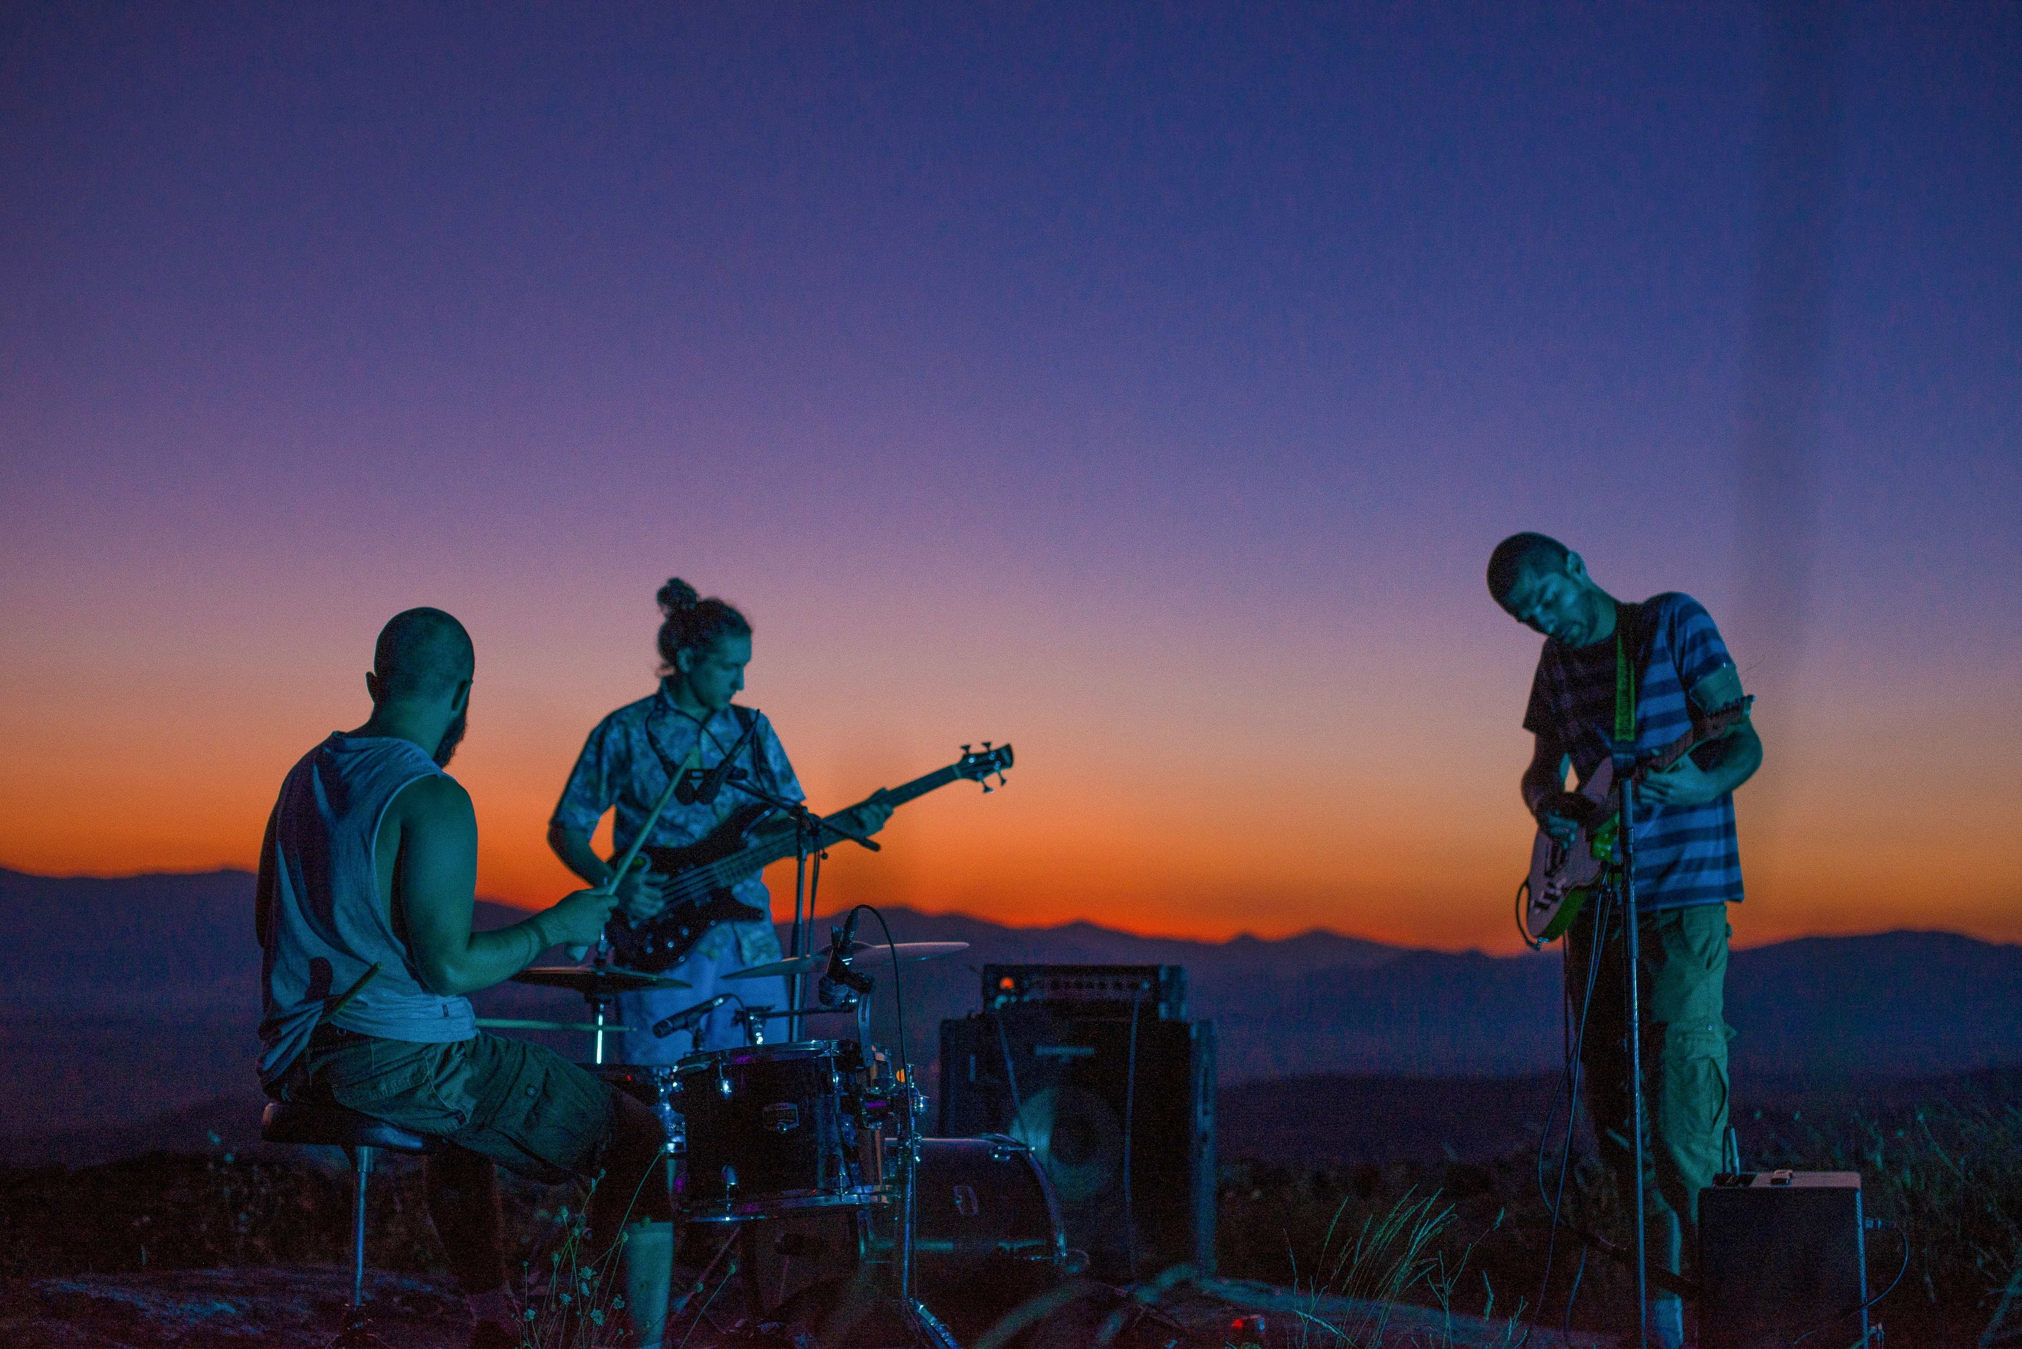
努力
Notes:
https://unsplash.com/photos/a-group-of-people-sitting-around-each-other-Eq2oz8U9Z5s
https://unsplash.com/photos/a-group-of-people-that-are-playing-guitars-DIXT8Z9p-Sg

Slide 6
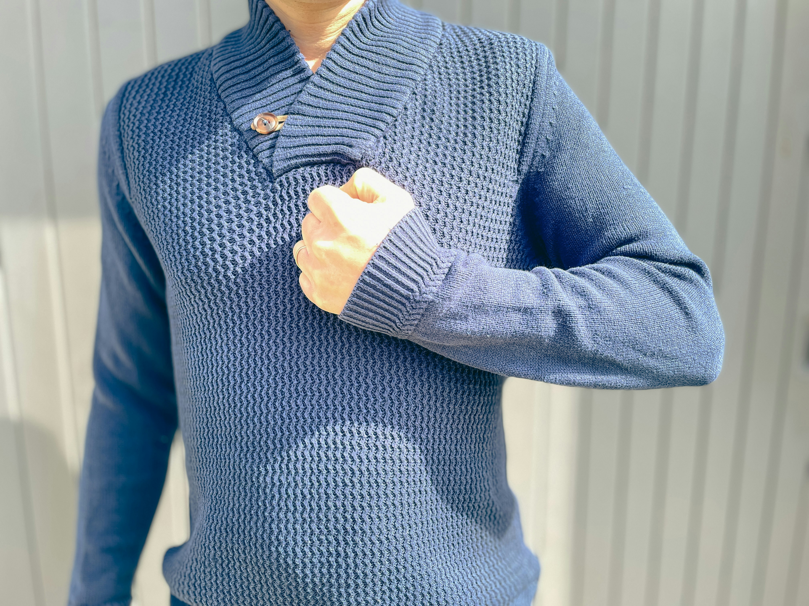
結果
Notes:
https://unsplash.com/photos/a-person-wearing-a-blue-sweater-and-holding-a-wii-controller-d4CNjsXRwAU

Slide 7
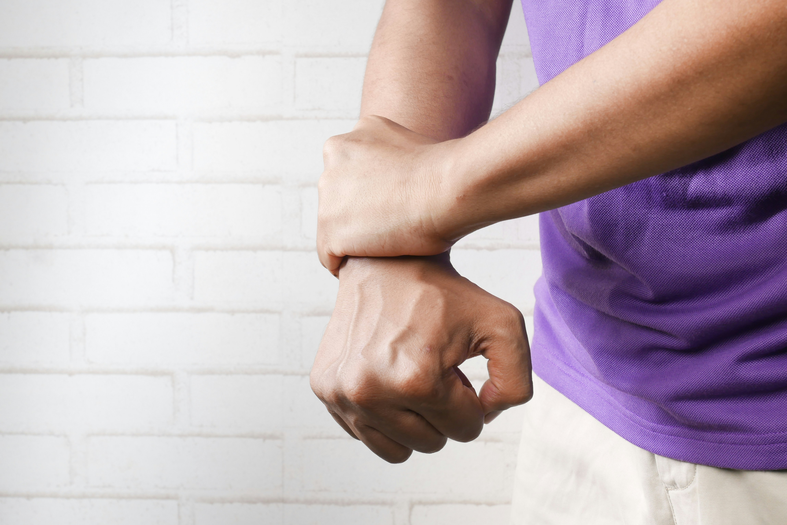
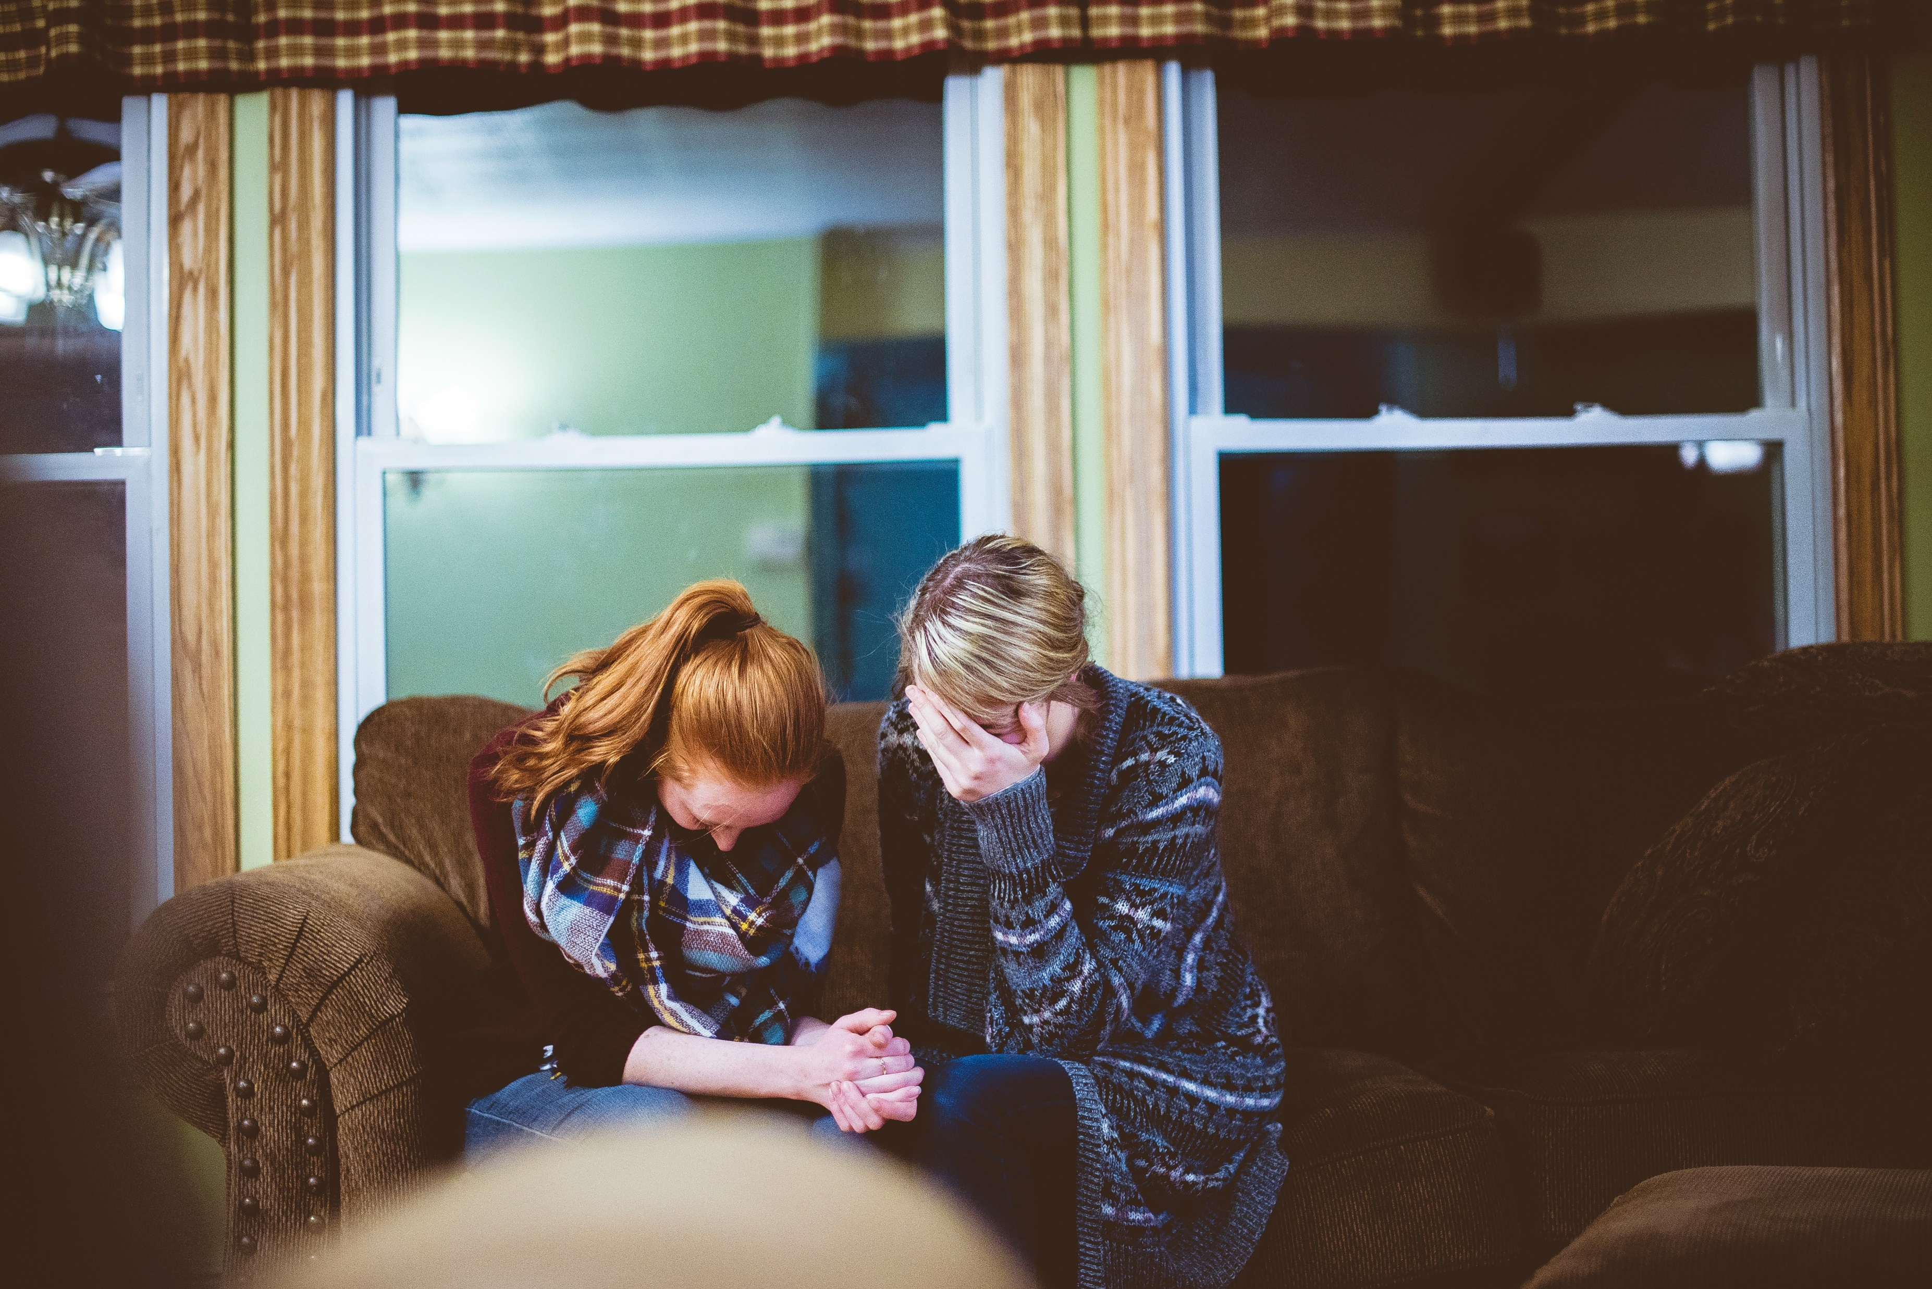
意外
Notes:
https://unsplash.com/photos/person-holding-hands-of-another-person-3AsiVDsZnHg
https://unsplash.com/photos/man-and-woman-sitting-on-sofa-in-a-room-e92L8PwcHD4

Slide 8

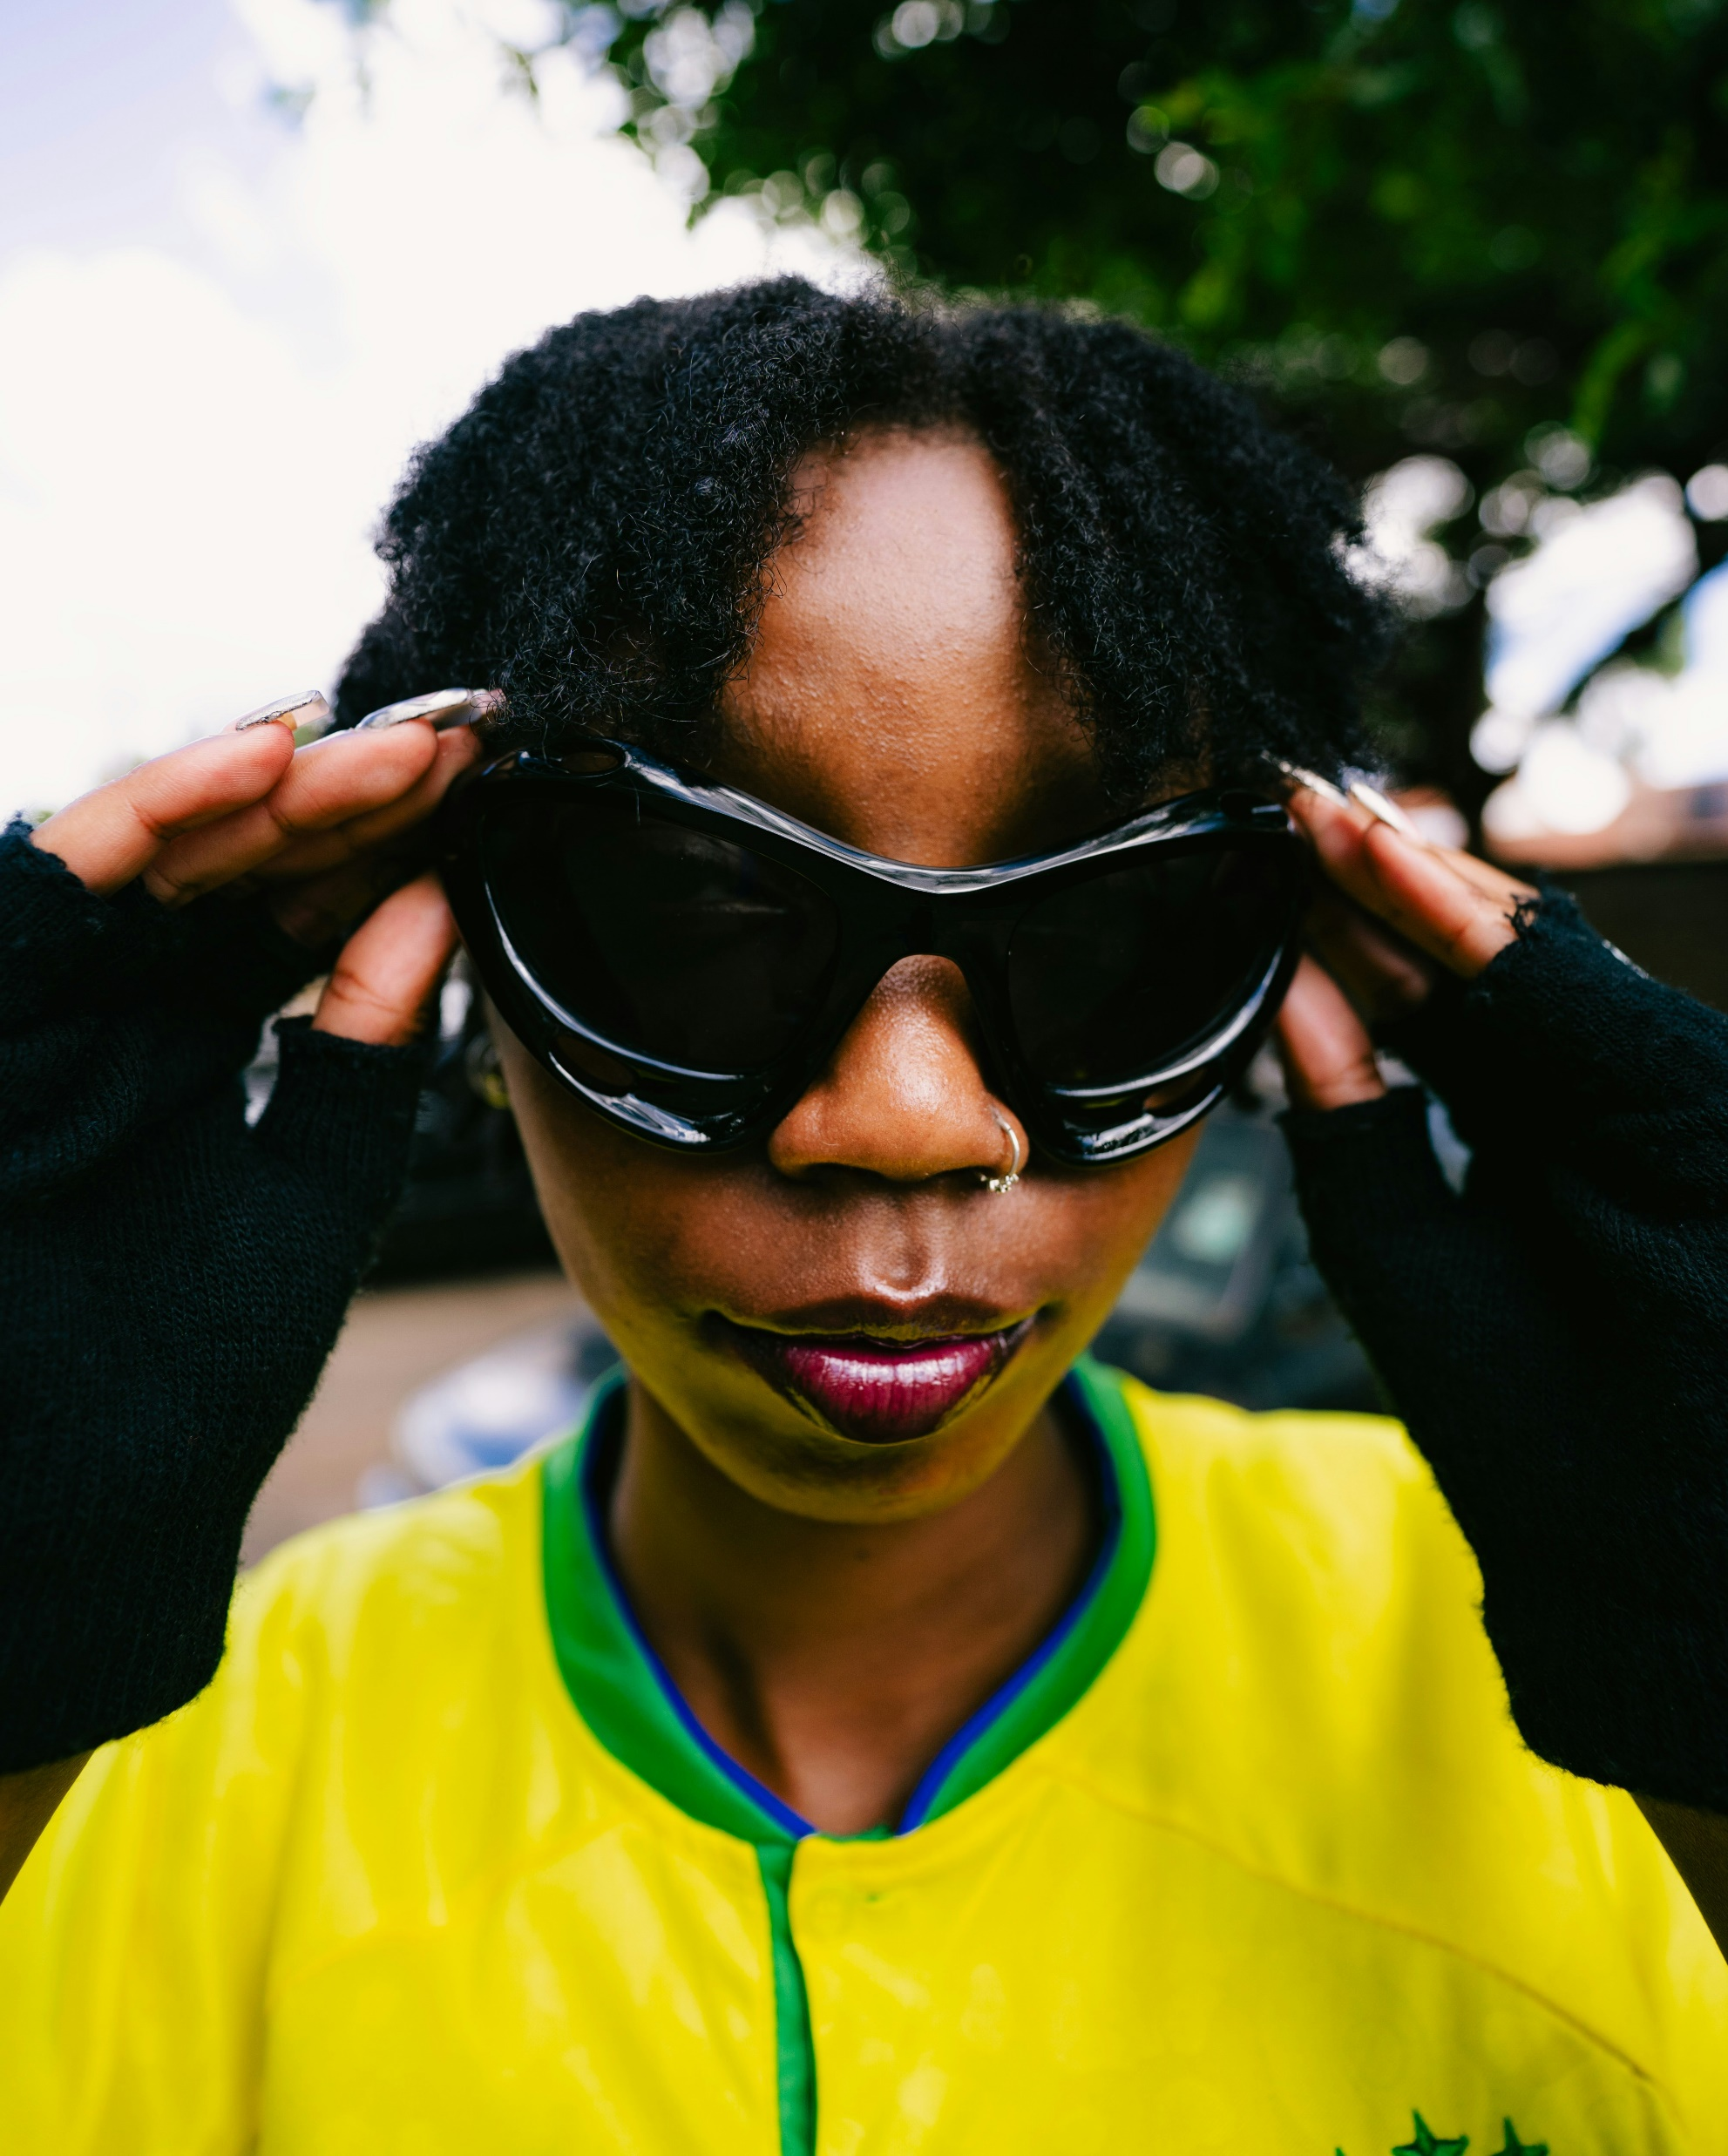
轉彎
Notes:
https://unsplash.com/photos/a-woman-wearing-sunglasses-and-a-yellow-shirt-DMeDcn0-FLw
https://unsplash.com/photos/a-toy-phone-sitting-on-top-of-a-counter-Mgf2Q2ck_kQ

Slide 9
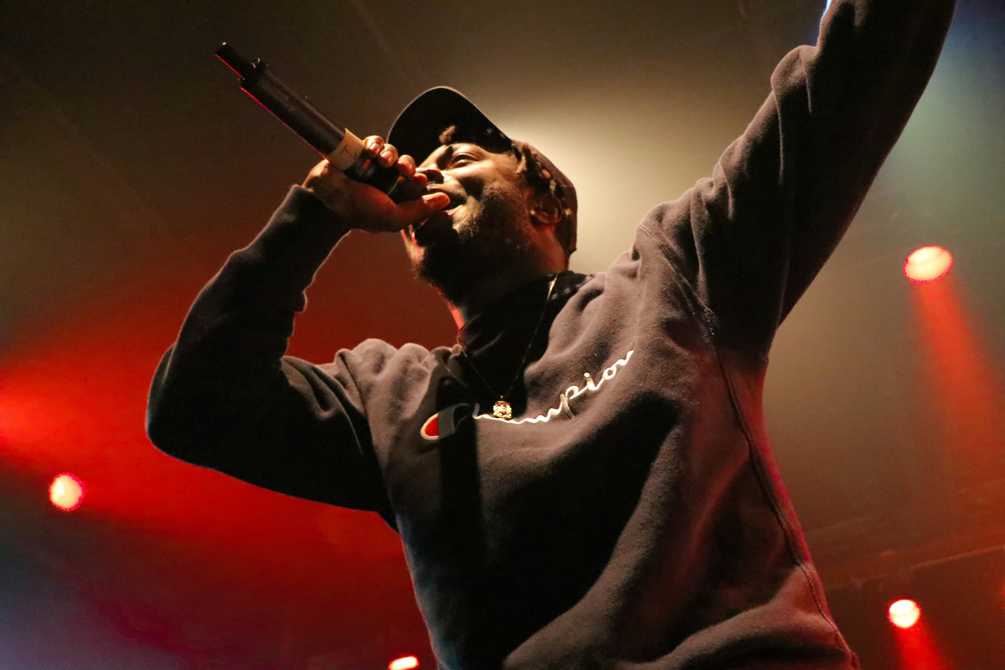
結局
Notes:
https://unsplash.com/photos/black-holding-microphone-and-singing-on-stage-0l0KjNoAfAk

Slide 10

Notes:
https://unsplash.com/photos/woman-in-red-tank-top-standing-on-rock-formation-during-daytime-ZjdS0nBcEHg

